Slide 1


Accessibility and Data Visualization
2025
frank.computer
Tool-making and guidelines
Frank Elavsky, fje@cmu.edu
hcii.cmu.edu, axle-lab.com, dig.cmu.edu
Notes:
Hey everyone, I am Frank Elavsky, a PhD student and researcher at Carnegie Mellon University. I research, engineer, design, and contribute to standards at the intersection of accessibility and visualization.
So, I do work with practitioners a lot. And by practitioner here I mean someone who is not a student and not an academic researcher. These are people who do a specific kind of work in a specific area. For me, these are primarily data visualization and data science practitioners. And in my research, I think about people building and making visualizations all day long. The heart of what I do is about changing the behaviors and outcomes in the ways people build interactive data science systems, tools, applications, products, and services. I believe in this fundamental right that everyone should have: access to data. And also access to understanding the insights we produce from data. And people with disabilities have been excluded from this right. We communicate pandemics with charts and graphs, as well as the state of our elections. Personal informatics from health to finance rely on data visualizations. These artifacts are ubiquitous, virtually everywhere. I want these visualizations, and more importantly the information and decision-making that they enable, to be available for people with disabilities.

Slide 2
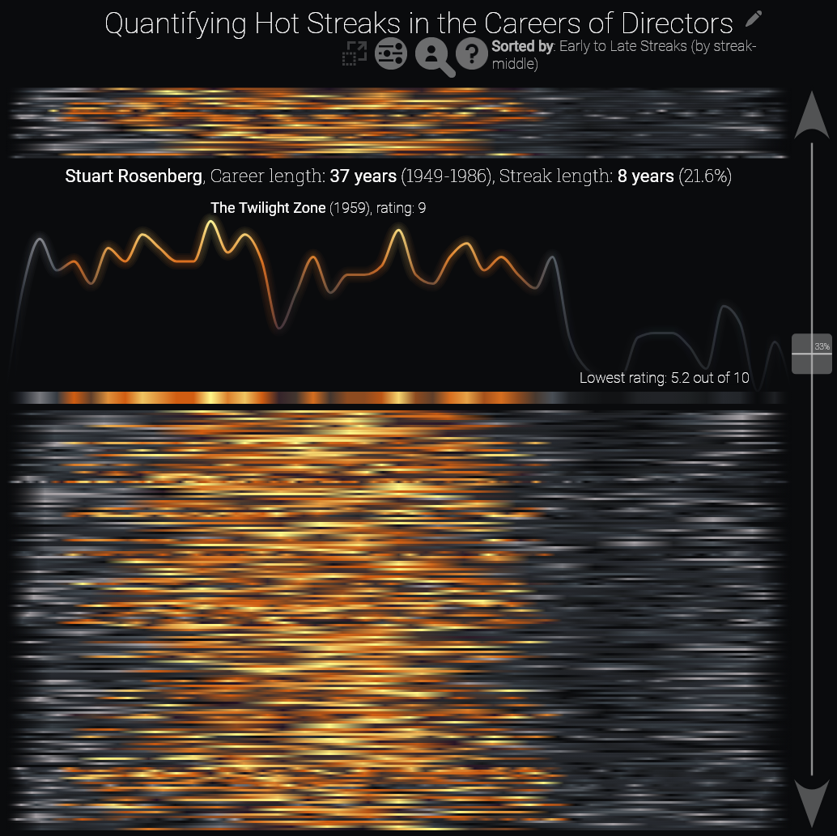
My pre-phd work: supporting others with tools
Industry and research-oriented visualization
Supporting data scientists
Visualizing a model of over 1m careers
Notes:
Most of my work, even before my PhD was focused on supporting practitioners. I of course have spent my phd focusing on this idea of “tool-making” as an intervention. My past career, before I started as a researcher, was also supporting others by making them tools. I’ve been a tool-maker for nearly a decade now.
I did a decent amount of work supporting policy analysts, folks at the DOJ/FBI, as well as social scientists, lawyers, and others.

Slide 3
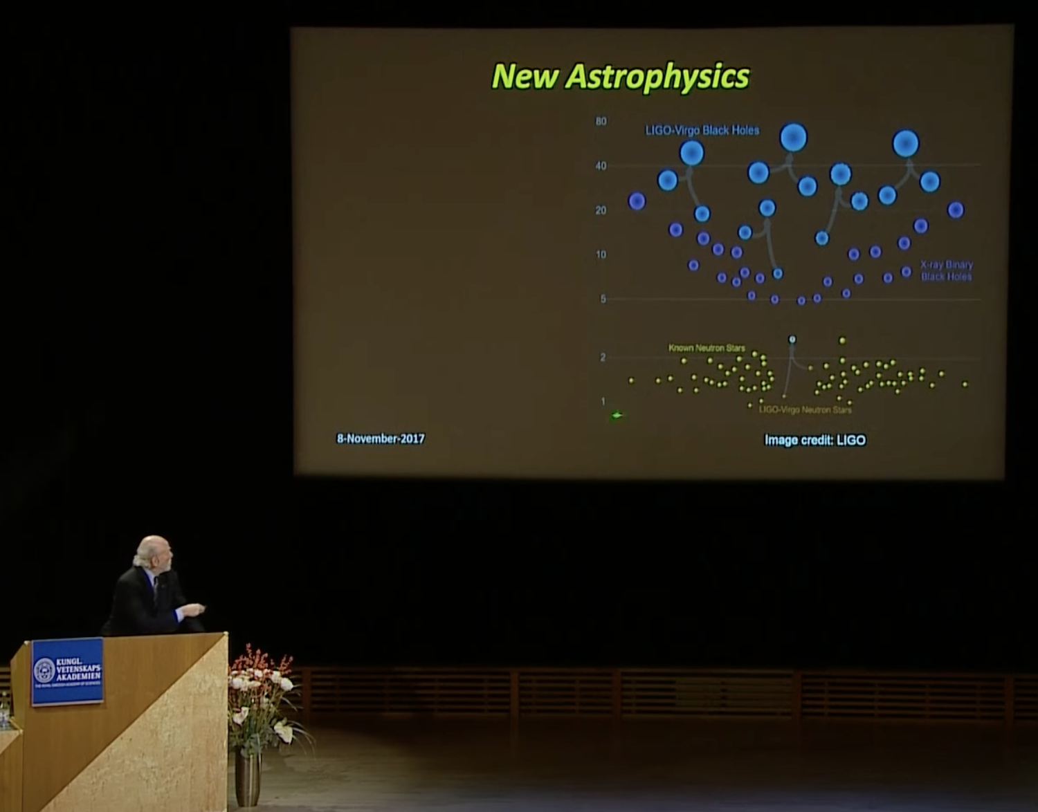
My pre-phd work: supporting others with tools
Industry and research-oriented visualization
Supporting data scientists
Supporting scientists
Visualizing a model of over 1m careers
Shown here is Barry Barish giving the Nobel Lecture in
Physics in 2017 with my visualization
Notes:
I also helped folks in physics, like this second graphic here is the Nobel Prize Winner giving the Nobel Lecture in Physics in 2017 and he is using my data visualization in his talk. That’s my chart! I’m unreferenced (it just says “credit LIGO” which is the group we worked with), but I still love to point that out.

Slide 4
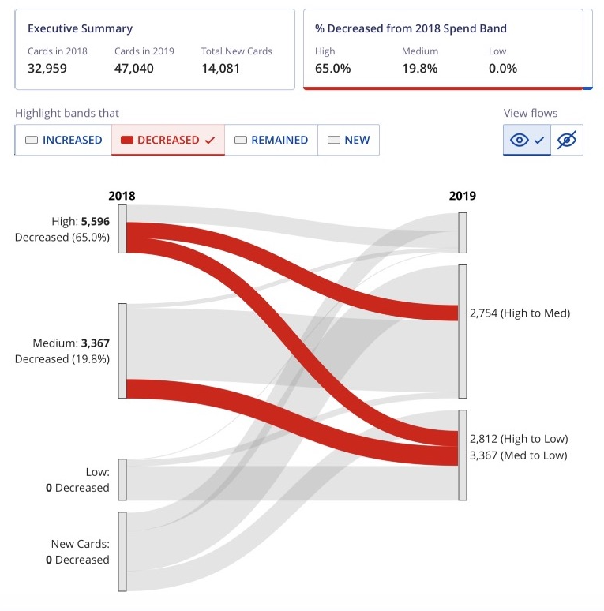
My pre-phd work: supporting others with tools
Industry and research-oriented visualization
Supporting data scientists
Supporting scientists
Supporting engineers
Visualizing a model of over 1m careers
Shown here is Barry Barish giving the Nobel Lecture in
Physics in 2017 with my visualization
Building a chart component library that supports 2000 devs and 200 products in 200 countries
Notes:
And of course, I supported analyst-engineers and professional builders, makers, and designers of corporate tools and products as well.
But this last role was interesting and different than my prior work. I wasn’t just trying to enable people to continue doing what they were already doing (science, analysis, etc). But at Visa, where we built this charting library on the right, I wanted my users (who were developers and designers) to make more accessible data visualizations. That is something that they weren’t doing already. And this turned out to be such a hard problem, that I left to pursue a PhD in this. How the heck do you get people to do things they don’t know how to do and might not even want to do?

Slide 5
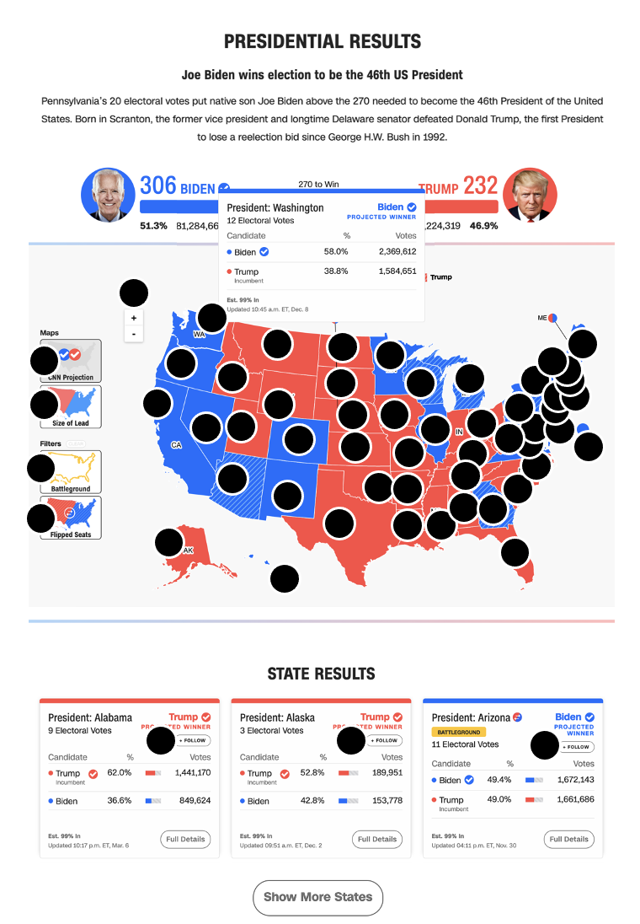
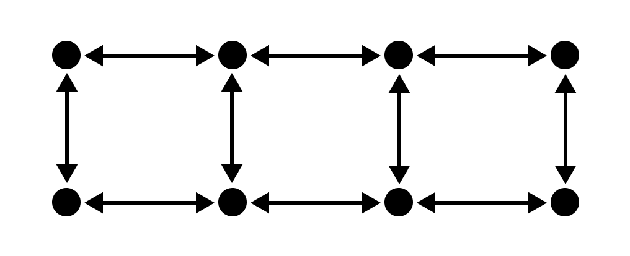

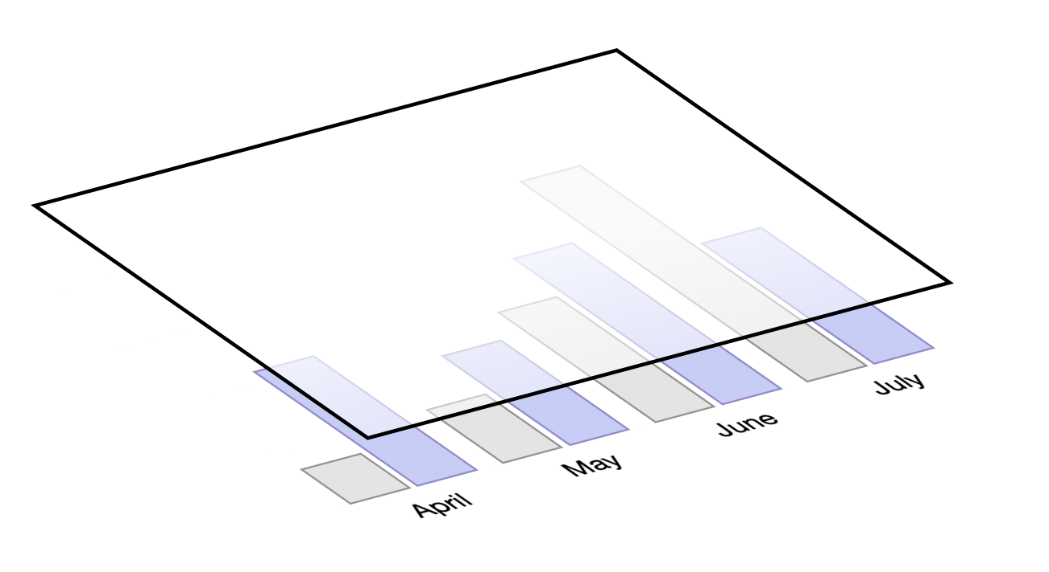
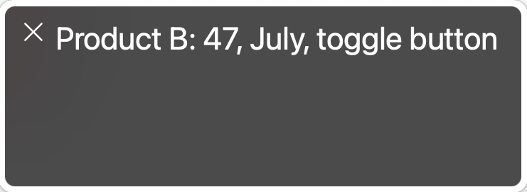
What and how of visualization accessibility
(My recent research)
Chartability:
What are accessibility barriers?
Data Navigator:
How do we build accessible visualizations?
Structure
Input
Rendering
To any visualization toolkit
Notes:
So I have 2 major published projects so far in my PhD, Chartability and Data Navigator. Chartability is about catching barriers. It’s essentially a list of 50 heuristics, with tools and methods, that practitioners can use to find accessibility barriers in their own work. I made Chartability because certain types of work, like data visualization, isn’t easily covered by WCAG and other accessibility standards. Chartability took all that it could from standards and synthesized those guidelines and tests for visualization and then we filled the rest of the gaps with research and community practices.
Data Navigator is my ideal tool for solving some of the hardest problems involved in making data visualizations and interactive data systems more accessible. You can have any graphic, rendered in any way, and use Data Navigator to design a rich experience for folks who use assistive technologies, like screen readers or keyboard-based tech too.

Slide 6
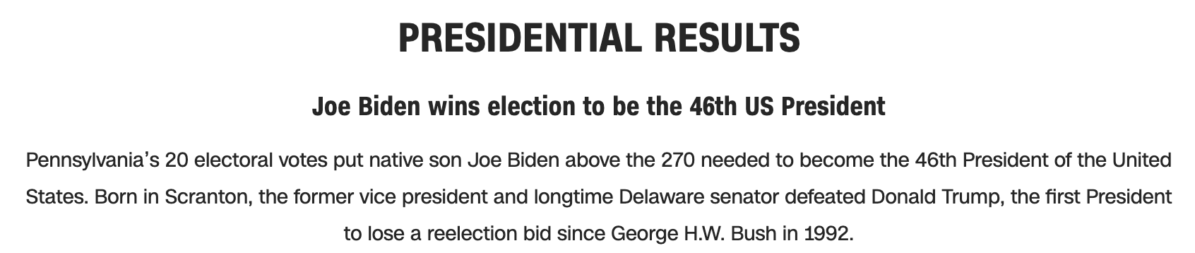
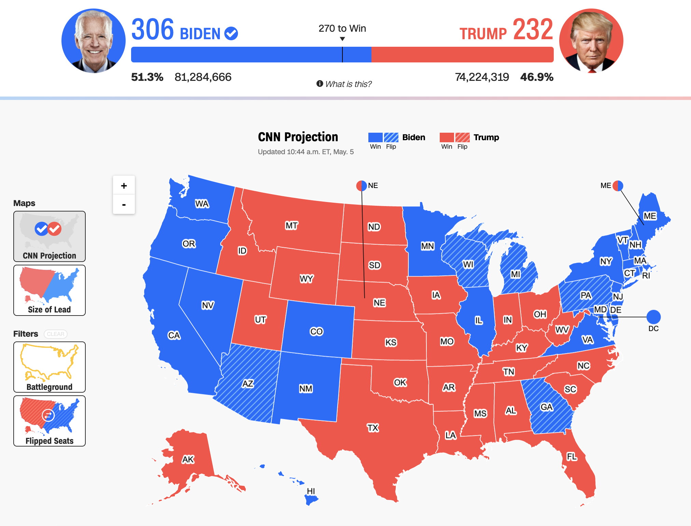
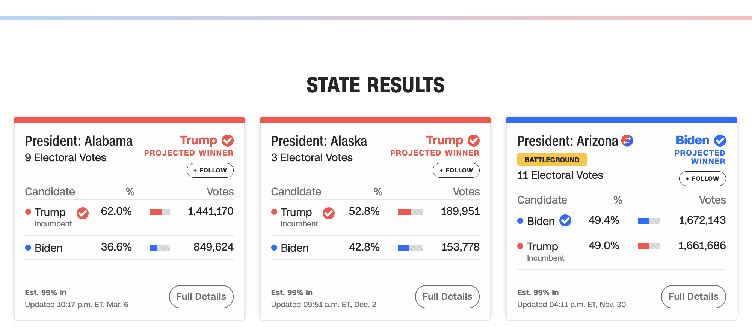

Chartability has helped me audit and train others
978 access failures found in ~60 minutes.
Robust:
275 - Does not conform to standards
82 - Semantically invalid
12 - Fragile technology support
Compromising:
54 - Information can only be reached through single process
61 - Information cannot be navigated according to narrative or structure
Assistive:
101 - Navigation and interaction is tedious
Flexible:
2 - User style change not respected
121 - User text adjustments are not respected
1 - Scrolling experiences cannot be adjusted or opted out of
Contrast and textures cannot be adjusted
Perceivable:
6 – Low contrast
57 - Content is only visual
50 - Color alone is used
3 - Meaningful elements can be distinguished
Operable:
54 - Interaction modality only has one input type
58 - No interaction cues or instructions
5 - Low contrast on interactive elements
4 - Keyboard focus indicator missing
4 - Complex actions have no alternative
18 - Target pointer interaction is too small
Understandable:
4 - Interactive context is not clear
6 - Metrics or variables are undefined
Notes:
Chartability is the subject of most of my 65 or so talks, workshops, and guest lectures that I’ve given in the past 4 years. I use it professionally to audit stuff because I still do consulting work at times, but it also helps me teach folks basic skills.
Shown on the screen here is a map of the US 2020 presidential election by the folks at CNN. This is an online interactive. And in a longer workshop session, I walk folks through a live audit of this where we catch nearly 1000 accessibility barriers using Chartability.

Slide 7
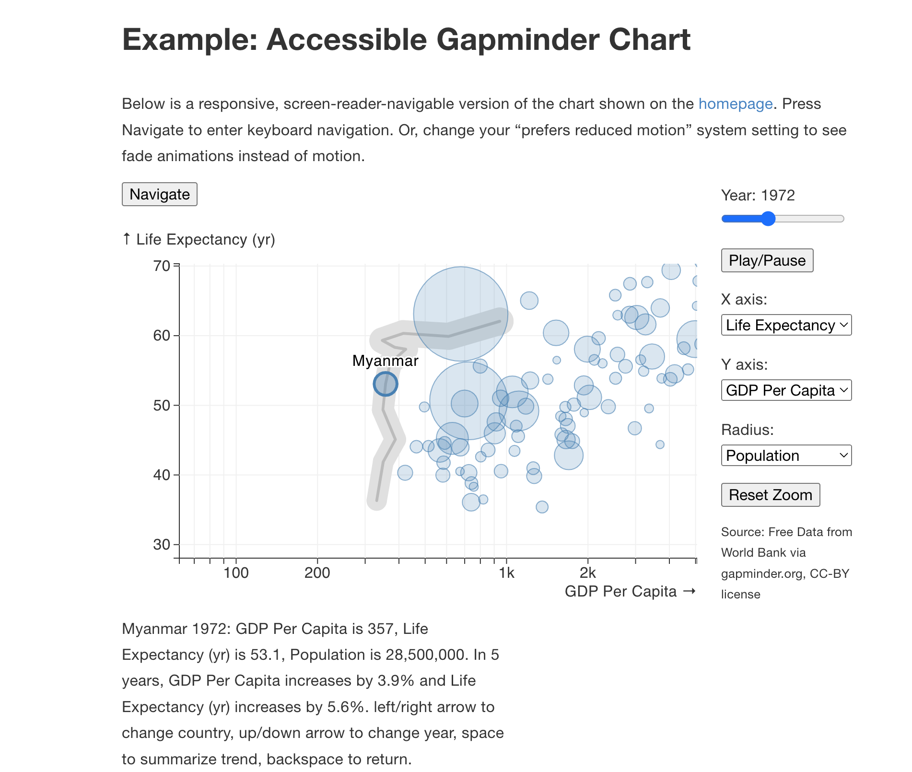
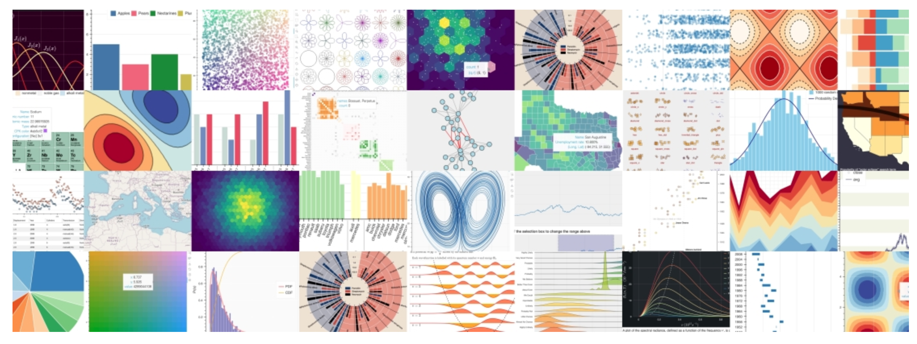
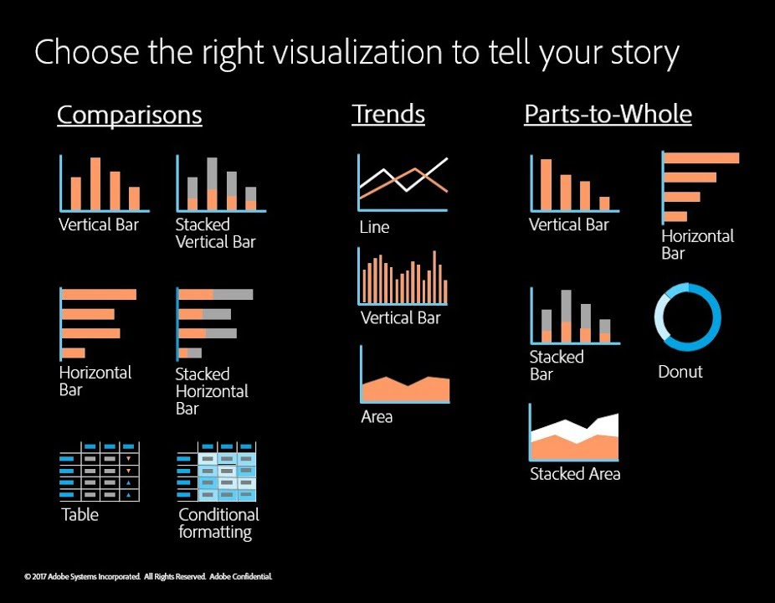
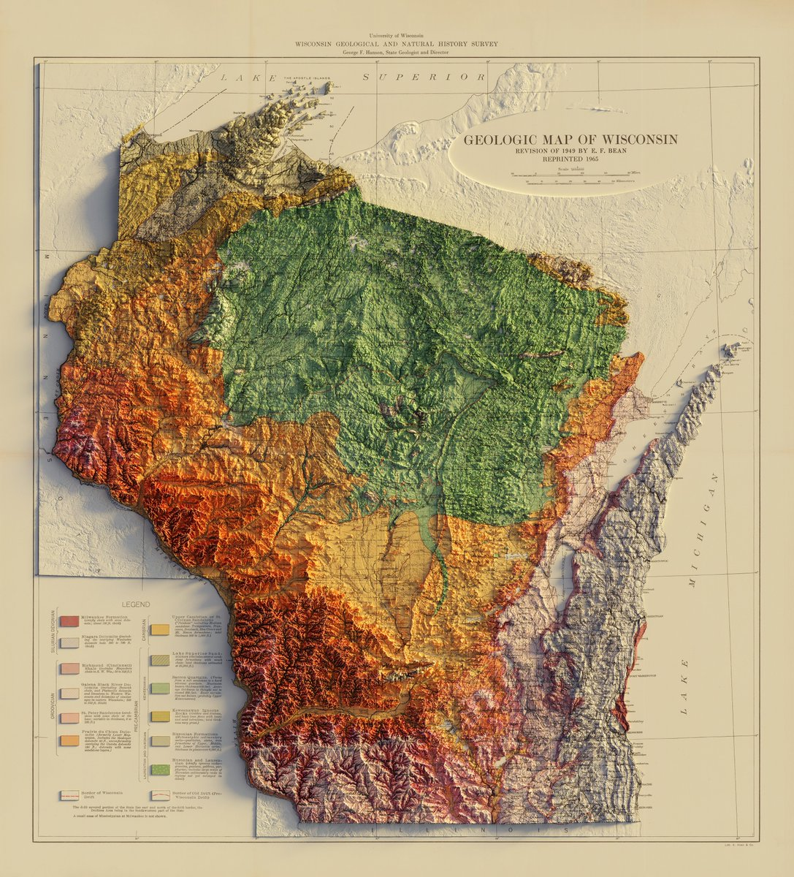
Data Navigator opened up collaborations with already-experts
Interactive demo link
Notes:
And Data Navigator is a project I am really excited about. I’m currently collaborating with a big data visualization library used in python called Bokeh, it gets about 4 million downloads per month and is just completely inaccessible. And I’m also working with folks at Adobe on making their open source charting library more accessible too.

Slide 8
A hard problem: Access Friction is when accessibility for someone produces a barrier for others
Notes:
But in this process, teaching and working alongside practitioners, a common question from audience members or a common barrier for designers and developers kept bubbling to the surface: Access friction. Access friction is when accessibility for one person or group of people might become a barrier for others.

Slide 9
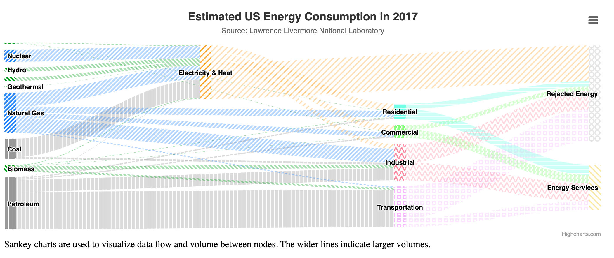
What about this is accessible? Why?
Notes:
For example, here is a visualization called a snaky diagram. Some things that might be accessible here could be the text hierarchy, strong contrast on the text labels, redundant encoding (that means unique color and texture combos), visual descriptions, as well as the alternative text (which isn’t shown here).

Slide 10
What about this might be a barrier? Why?
Notes:
But many of these things I’ve listed could also be barriers for different people. These textures in particular, I love to point out, are a bit overwhelming for me personally. This creates a sort of clutter that is hard for me to look at.

Slide 11
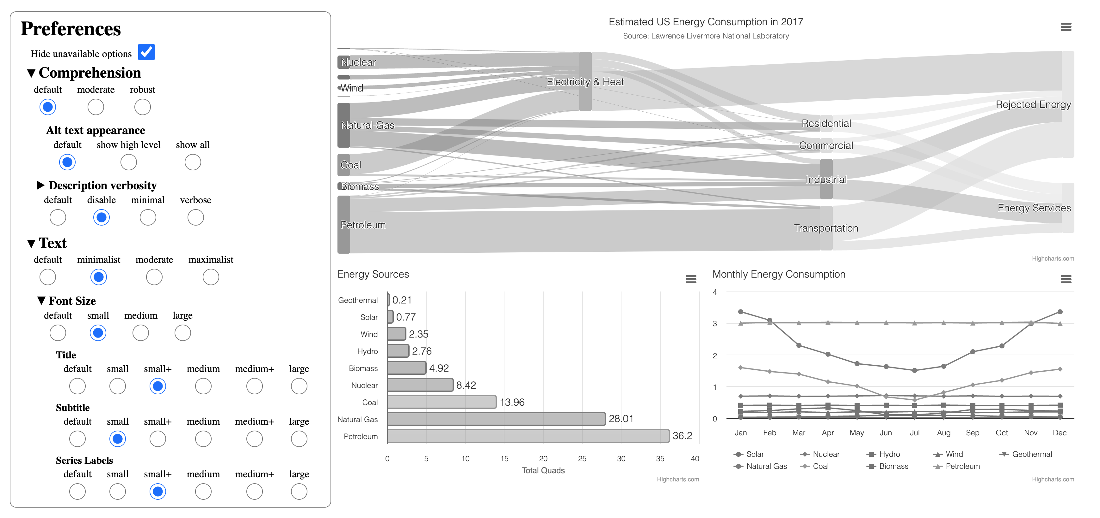
Softerware: malleable systems with guardrails
Interactive demo link
Notes:
What I’m interested in right now from a research perspective are how practitioners can build systems that allow end users to control the designs of systems they use regularly, like in work settings. Can we build malleable systems with a few guardrails in place?
I’ve got a paper on this concept (under review) I’m calling Softerware. And I’ll be giving a talk later today on this too (come check us out at 2:20pm).

Slide 12
Accessibility and Data Visualization
2025
Slides here
frank.computer
Tool-making and guidelines
Frank Elavsky, fje@cmu.edu
hcii.cmu.edu, axle-lab.com, dig.cmu.edu
Notes:
And that’s what I’ve been up to!
Of course, I look forward to our discussion today but I also want to encourage any of you to reach out to me if you want to work together, discuss your challenges, or even embark on a research collaboration together. I’m a consultant but also a researcher and I’m especially interested in ways to fuel my work that doesn’t rely so heavily on federal grants, as I’m sure some of you could imagine. So shoot me an email, I’d love to hear what you’re up to more in detail.

